Slide 1
Action Workshop Template
BOOK TOOL
How Hard Is It to Be Your Customer?
Using Journey Mapping to Drive Customer-Focused Change

Slide 2
Teams
[INSERT TEAM BREAKDOWN – make sure you have broad representation in each team, with a maximum of 6 participants/team.

Slide 3
Agenda Day 1
Time | Agenda Item
1:00 | Voice of the Customer – Report from the journey map.
2:30 | Break
2:45 | Learnings and Observations – Teams document what was learned, and what it means.
3:15 | Future-State Outcomes Map – Teams share what they want customers to say, think, feel, and do in the future.
3:45 | Customer Journey Measurement – How do we know when customers succeed?
4:30 | End of Day 1

Slide 4
Agenda Day 2
Time | Agenda Item
8:30 | Breakfast and coffee
9:00 | Welcome - Reflection on Day 1 | Day 2 workshop roadmap.
9:10 | Recommendations – Improvement ideas.
9:45 | Initiatives – Teams generate possible ideas focused on customer critical moments.
10:45 | Break
11:00 | Idea Voting – Teams narrow the list, and select ideas to bring forward.
11:15 | Idea Sharing – Teams share their top 3 strategic ideas and top 2 quick wins with the greater team.
11:30 | Idea Selection – Each team selects 1 quick win and 1 strategic idea.
11:45 | Prepare Quick Win Idea Cases – Teams develop details for 1 quick win.
Time | Agenda Item
12:00 | Lunch served/available
12:45 | Prepare Strategic Idea Cases – Teams develop details for 1 strategic idea.
1:30 | Five Questions – Teams share 5 questions on others’ strategic idea cases.
1:45 | Finalize Cases/Build Storyboard – Finalize the approach and build storyboards.
2:30 | Break (continue working on storyboards)
3:30 | Ideas Presentation – Teams present ideas and provide feedback to strengthen plans.
4:15 | Immediate Change – Exercise to identify “one thing I’ll do differently to support customers.”
4:30 | End of Day 2

Slide 5
Company Objectives
    Find Moments of Truth and Friction Points for the customers’ [INSERT YOUR JOURNEY HERE] to improve [INSERT what you would like to improve].
    Create an exceptional [INSERT YOUR JOURNEY: example- onboarding] experience for customers across products and services.
The success of this initiative will be judged by:
[INSERT SPECIFIC GOALS AND KPIs HERE].

Slide 6
Customer Immersion Methodology
[INSERT INTERVIEW PARTICIPANT PROFILE – broken down by things like age, gender, customer segment, location etc., include information on how data was collected]

Slide 7
Action Workshop Key Activities Roadmap
Innovate for Improved State
Hear
Customer Voice
Start
Finish
Envision
the Future
Develop Top Ideas

Slide 8
Customer Goals

Slide 9
Customer Goals

Slide 10

M ments of Truth and Fr!ction Points

Slide 11
INSERT MAP/MAPS HERE

Slide 12
Key Themes & Findings

Slide 13
Key Theme [Insert Key Theme]
Insert top insights from the full report – be sure to include videos.
Xx
[INSERT CUSTOMER QUOTE ALIGNING WITH THIS KEY THEME. USE VIDEO IF AVAILABLE.
  Customer, type

Slide 14
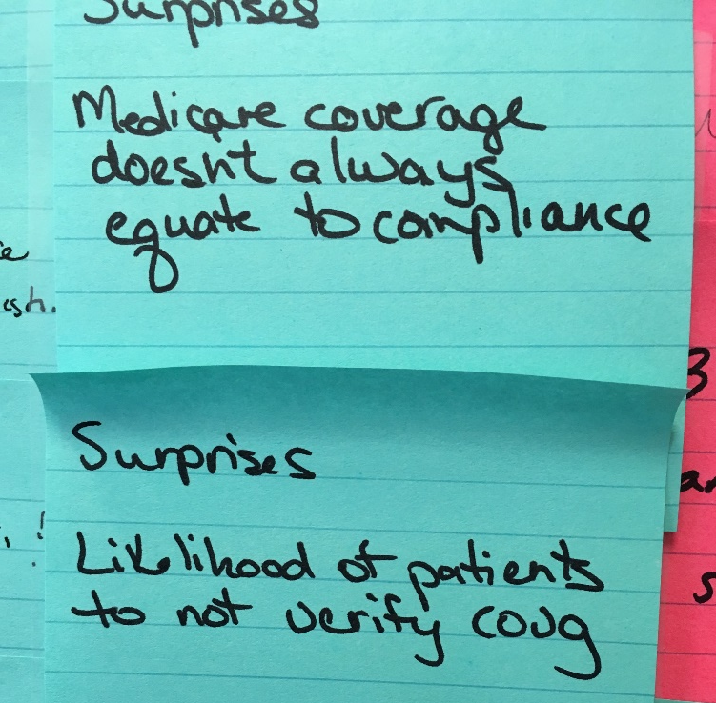
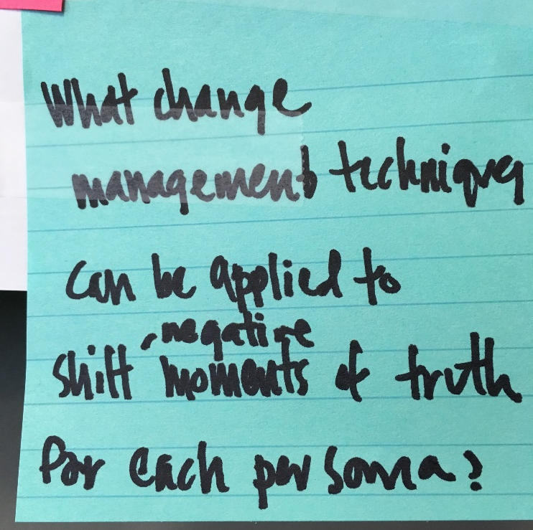
Collecting Learnings
On the Post-it Notes, write:
Beliefs confirmed
Surprises
What questions you still have
Be sure to label the Post-it Notes appropriately.
Notes:
PREP: Use three different flip charts labeled for each: Questions, Surprises, Questions

Slide 15
Action Workshop Key Activities Roadmap
Innovate for Improved State
Hear
Customer Voice
Start
Finish
Envision
the Future
Develop Top Ideas

Slide 16
Outcome Mapping Envision the Future
Within your team, picture what you want your customers to think, feel, say, and do as they go through the journey.
Put your answers on Post-it Notes, then place them in the appropriate area on the 2x2 matrix.
Think
Feel
Say
Do
Notes:
Prep: Have either a large 3’x3’ butcher paper prepped with quadrants, or two side by slide flip charts/team.

Slide 17
Recommendations

Slide 18
Recommendations [Insert]
Use industry or company research to back up your recommendations.
Xx
[INSERT CUSTOMER QUOTE ALIGNING WITH THIS KEY THEME. USE VIDEO IF AVAILABLE.
  Customer, type

Slide 19
Action Workshop Key Activities Roadmap
Innovate for Improved State
Hear
Customer Voice
Start
Finish
Envision
the Future
Develop Top Ideas

Slide 20


Action Planning Exercise
Generate ideas to improve the customer experience.
Write actions/ideas to improve:
1. Moments of Truth.
2. Overall journey.
On your own, write down all your ideas for how to improve the experience of your customers’ first critical moments. Take 10 minutes.
  Print ideas on Post-it Notes, with one idea per note.
  Follow color scheme for each moment of truth.
  Ensure your ideas are written out in enough detail that someone in leadership can read them and know what you mean.
Moment of Truth #1
Moment of Truth #2
Moment of Truth #3

Slide 21
Ideation Customer Impact Matrix
Use a customer lens to identify ideas with the biggest impact!
Each team member should explain their ideas to the rest of the group.
As each idea is explained, place it on the matrix with the help of the team. Together you will decide the:
  Level of impact/benefit to the customer.
  Level of effort to implement.
Make sure to ask questions if you need more information about an idea.
High
Idea #1
Idea #8
Idea #9
Idea #4
Idea #3
Idea #5
Customer Impact
Idea #2
Idea #11
Idea #7
Idea #10
Idea #6
Low
Effort/Complexity
High
Notes:
Prep: Have either a large 3’x3’ butcher paper prepped with quadrants, or two side by slide flip charts/team.

Slide 22
Within Each Team Ideation Prioritization
Narrow the list of ideas within each team.
Each member of the team will receive dots/stickers to place on the customer matrix to indicate their favorite ideas.
Each team member will receive dots for voting on the top ideas to move forward:
  5 blue per person for strategic
  3 green per person for quick wins
Select 5 ideas to bring to the main room:
  3 strategic ideas
  2 quick wins

Slide 23
Action Workshop Key Activities Roadmap
Innovate for Improved State
Hear
Customer Voice
Start
Finish
Envision
the Future
Develop Top Ideas

Slide 24
Building a Vision for the Improved Experience
Idea name:
Vision/description:
Moment of Truth addressed:
Improved customer outcomes:
Improved company outcomes:
Resources needed/timing:
KPI/measurement:
Champion:
Prepare Quick Win / Strategic Idea Case
In your team, complete the framework for describing one idea in detail.
  Ensure the initiatives are written out in enough detail that someone in leadership can read them and know what you mean.
Document:
  What insights led to this idea.
  Your vision for this idea.
  The customer impact.
  Resources needed.
  Who is responsible for the next steps.
Notes:
Prep: 1 flipchart/team

Slide 25
Workshop Immediate Change
Share your thoughts on the Action Workshop, and what you will do
On Post-it Notes, record:
The one thing you will do differently to better serve customers as a result of the workshop and discussions.
I like…
I wish…
Notes:
Prep: 1 flip chart for each bullet listed above. (total- not per team)

